Slide 1
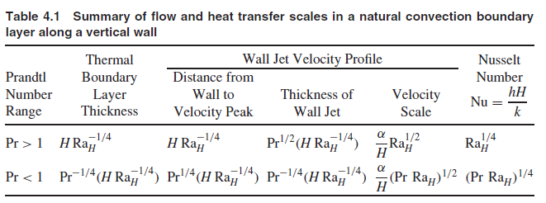

Slide 2
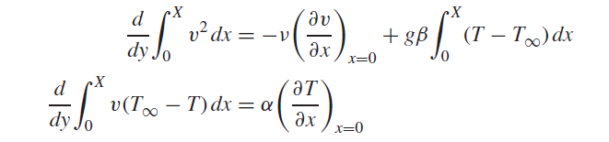
Integral solutions
Integrating the momentum equation and the energy equation from the wall (x = 0) to a far enough plane x = X in the motionless isothermal cold reservoir, we obtain the integral boundary layer equations for momentum and energy,
(1)
(2)

Slide 3

High-Pr Fluids
A suitable set of profiles for Pr > 1 fluids
(3)
1. In the limit Pr→∞, this solution reduces to
and

Slide 4

Low-Pr Fluids
For a Pr < 1 fluid, the temperature profile is combined with a new velocity profile:
(4)
In the limit Pr→0, these results become
and

Slide 5
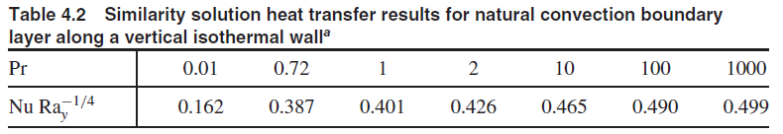
Similarity solutions
The similarity variable emerges as
and

Slide 6
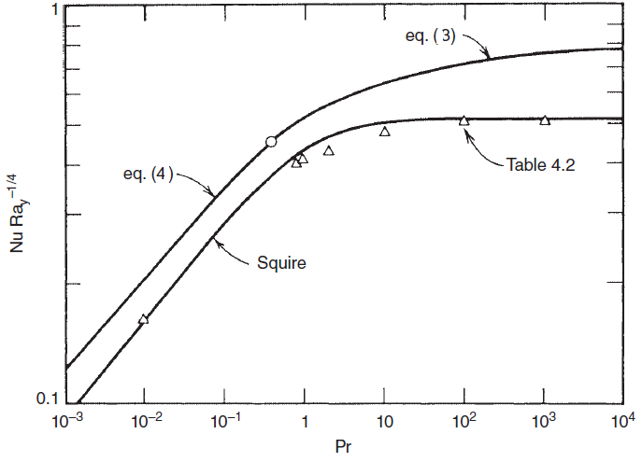
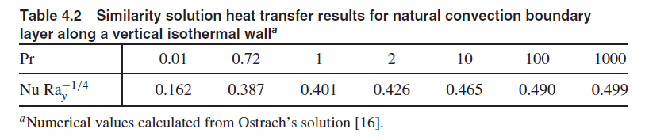
H. B. Squire, in S. Goldstein, ed., Modern Developments in Fluid Dynamics, Vol. II, Dover, New York, 1965, pp. 641–643.

Slide 7


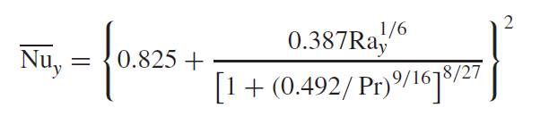
HEAT TRANSFER RESULTS INCLUDING THE EFFECT OF TURBULENCE
An empirical isothermal-wall correlation that reports the wall-averaged Nusselt
number Nuy for the entire Rayleigh number range—laminar, transition, turbulent
Churchill and Chu [33]

Slide 8
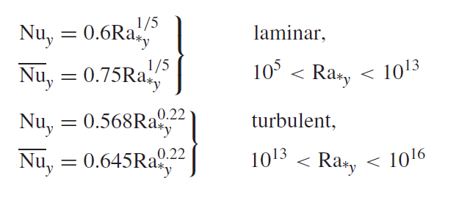
When the vertical wall is heated uniformly
Vliet and Liu (34)

Slide 9
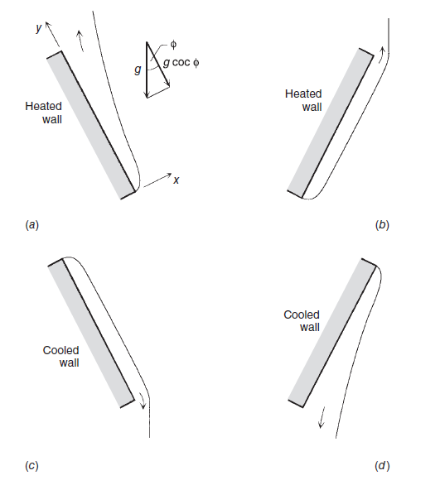

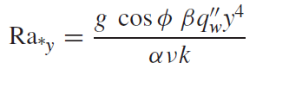
Inclined Walls
Isothermal wall
Uniform heat flux

Slide 10
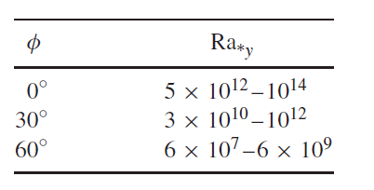
laminar–turbulent transition,
The uniform-flux wall is oriented as in cases a and d
in water experiments (Pr∼= 6.5)

Slide 11
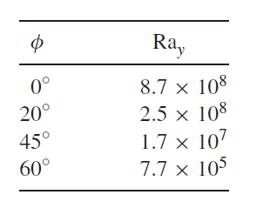
laminar–turbulent transition
Effect of wall inclination on transition along an isothermal wall [37]

Slide 12
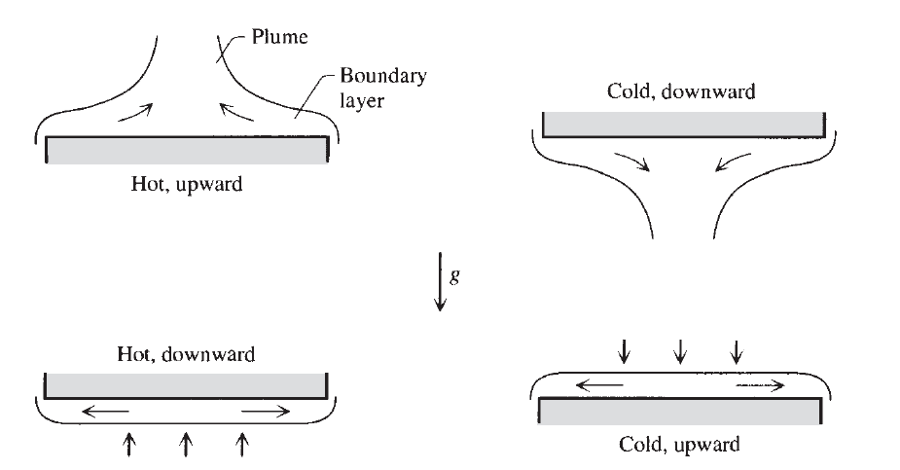

Horizontal Walls
Characteristic length

Slide 13
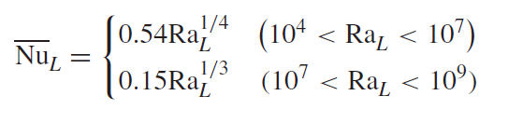

Isothermal surfaces
In the case of hot surfaces facing upward or cold surfaces facing downward the Nusselt number varies as [40]
Pr> 0.5
Correlation for hot surfaces facing downward or cold surfaces facing upward (Fig. bottom) is (41)

Slide 14
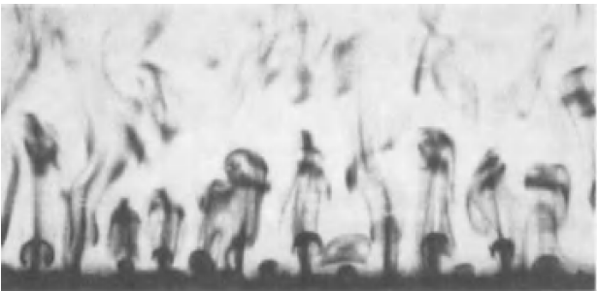
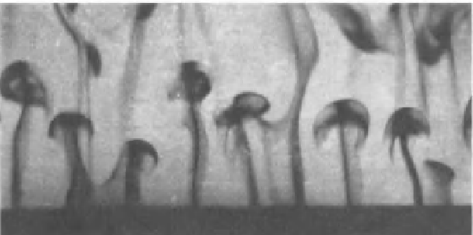
Thermals
Intermittent rise of heated fluid (thermals) from a horizontal surface facing upward in a colder pool of water Journal of Fluid Mechanics, Vol. 41, pp. 793–800, 1970.
When the temperature difference is sufficiently large

Slide 15
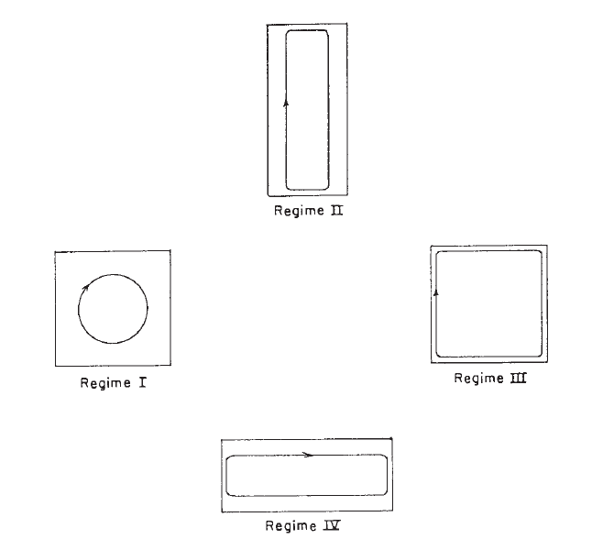
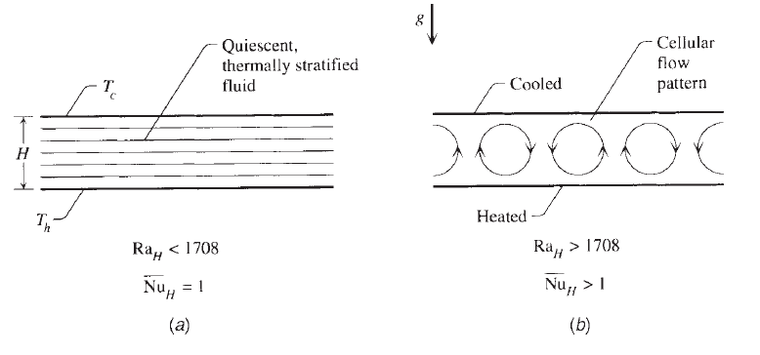
Internal Natural Convection
enclosures heated from the side.
enclosures heated from below.
Critical Rayleigh number
Ra_{H} >~1708
Circulation patterns associated

Slide 16
